Slide 1
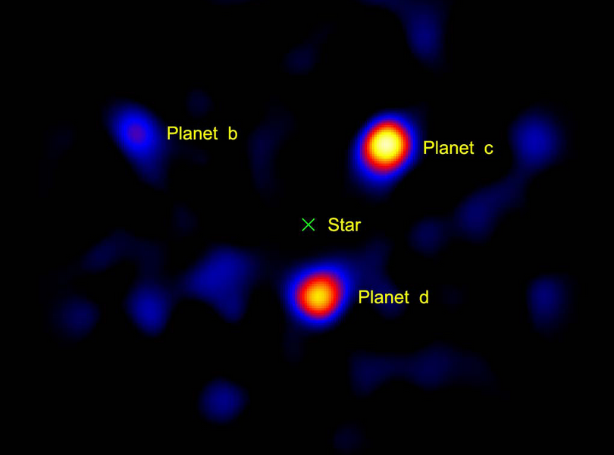
Mass-Radius Relationships for Exoplanets
credit: Hale Telescope, 2010
Alejandro Lorenzo, Arizona State University

Slide 2
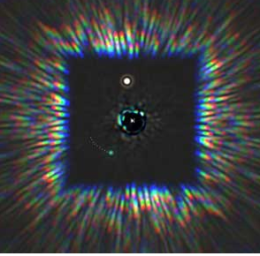
What are they? Why study them?
Exoplanet - a planet outside of the solar system
- they all appear to be unique in their own way
- change how we study our own SS
- how common are we?
- Well, its interesting
Credit: GPI

Slide 3
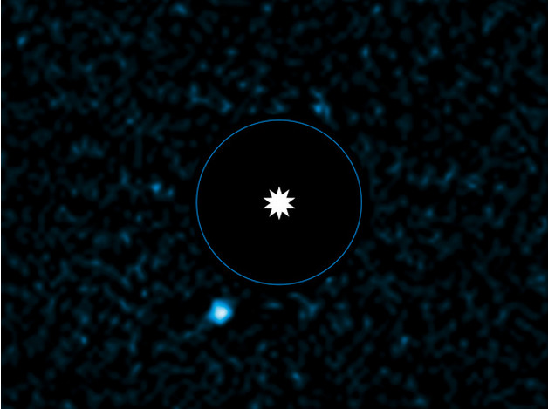
What we see
Credit: VLT Image ESO/J. Rameau

Slide 4
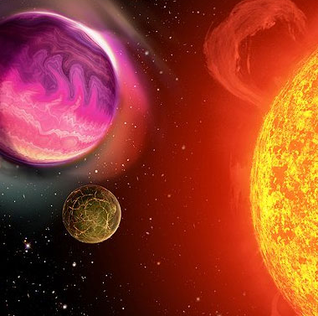
What an artist thinks we see
Credit: artist

Slide 5
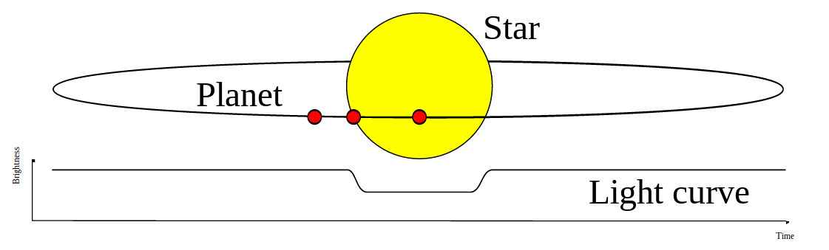
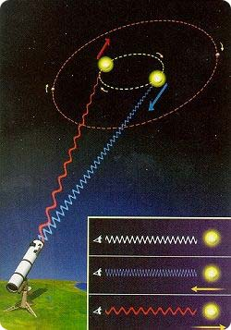
Finding an Exoplanet
Other methods: Direct imaging (IR), microlensing, Timing(pulsars, variable stars), reflected light
These are the current most popular planet hunting methods
  Transiting method will yield: orbit parameters, inclination and radius
    if host star is sufficiently bright, it is possible to get atmospheric composition, effective temperature/albedo, inner structure and composition constraints
  Radial velocity method will yield: orbit parameters. minimum planet mass (m*sin(i))

Slide 6
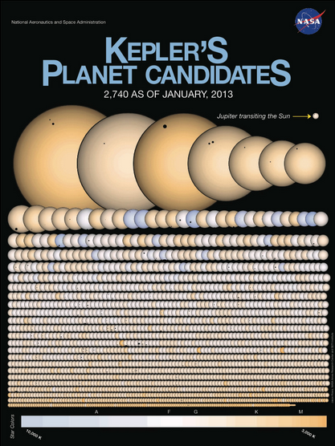
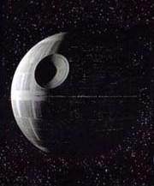
Pencil, paper, simulate
There are possibly several thousand more planets than we currently know of
  Planet candidates are pending planets that require follow up observations
Once confirmed, the next step is to find out
what the planets are made of
Otherwise…

Slide 7
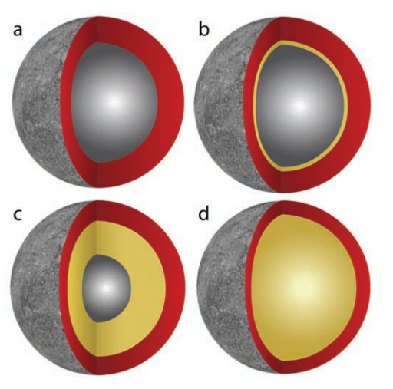
Modeling Exoplanets
Credit: Riner et al

Slide 8
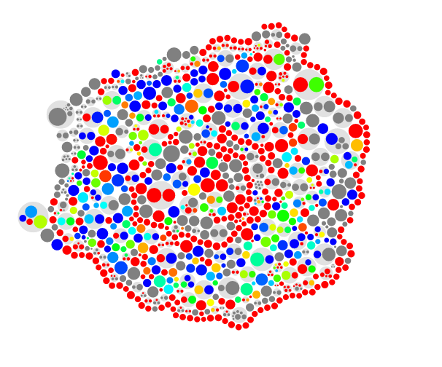

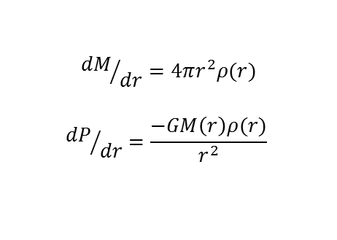
Equations
Hydrostatic Equilibrium
$${dM}/{dr}=4πr^{2}ρ(r)$$
$${dP}/{dr}=\frac{−GM\left(r\right)ρ(r)}{r^{2}}$$
Equation of State
$$P= \frac{3}{2}K_{T,0}\left[α^{\frac{7}{3}}−α^{\frac{5}{3}}\right]\left(1+\frac{3}{4}(K_{p}^{′}−4)\left[α^{\frac{2}{3}}−1\right]\right)$$

Slide 9
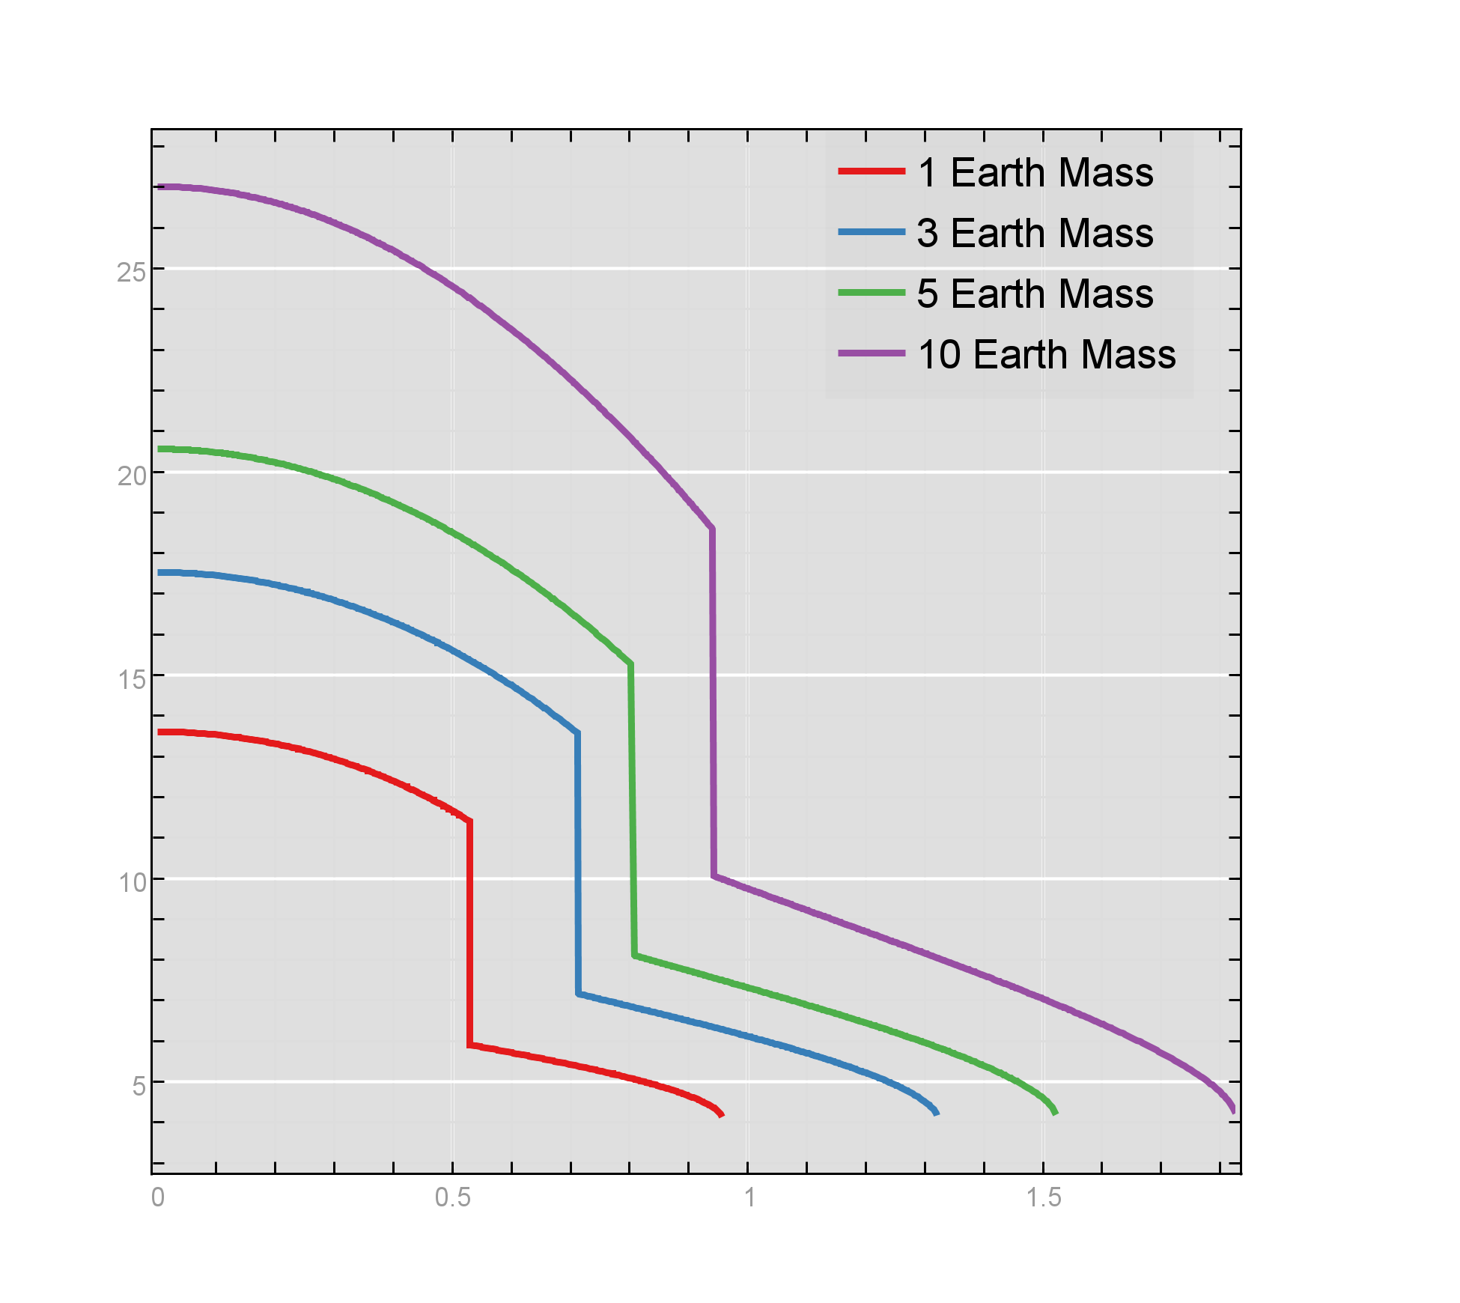
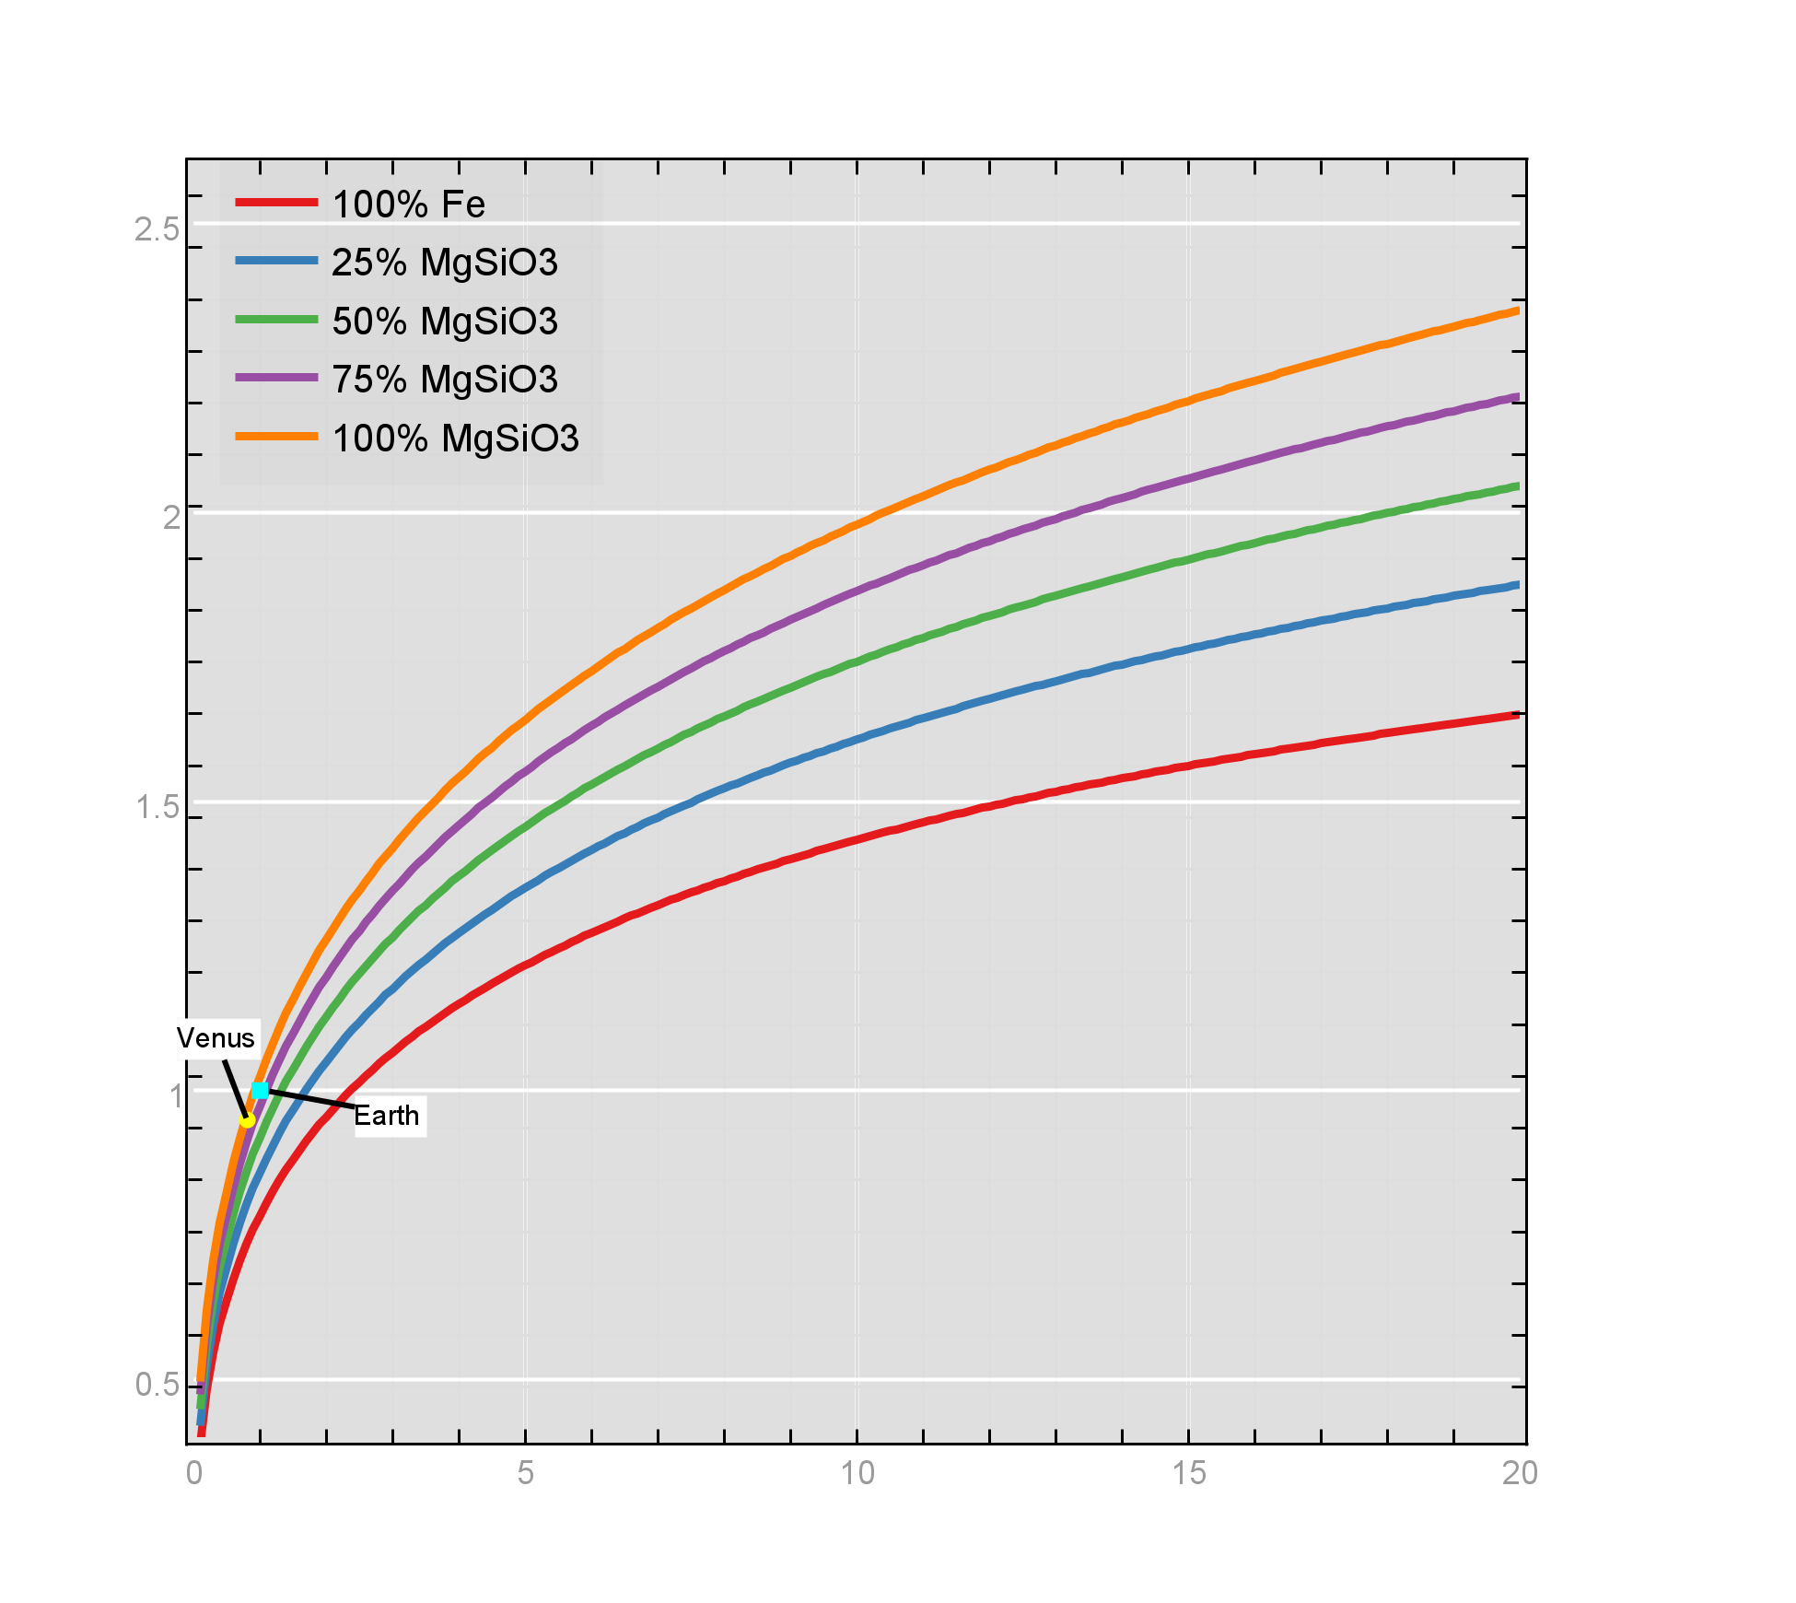
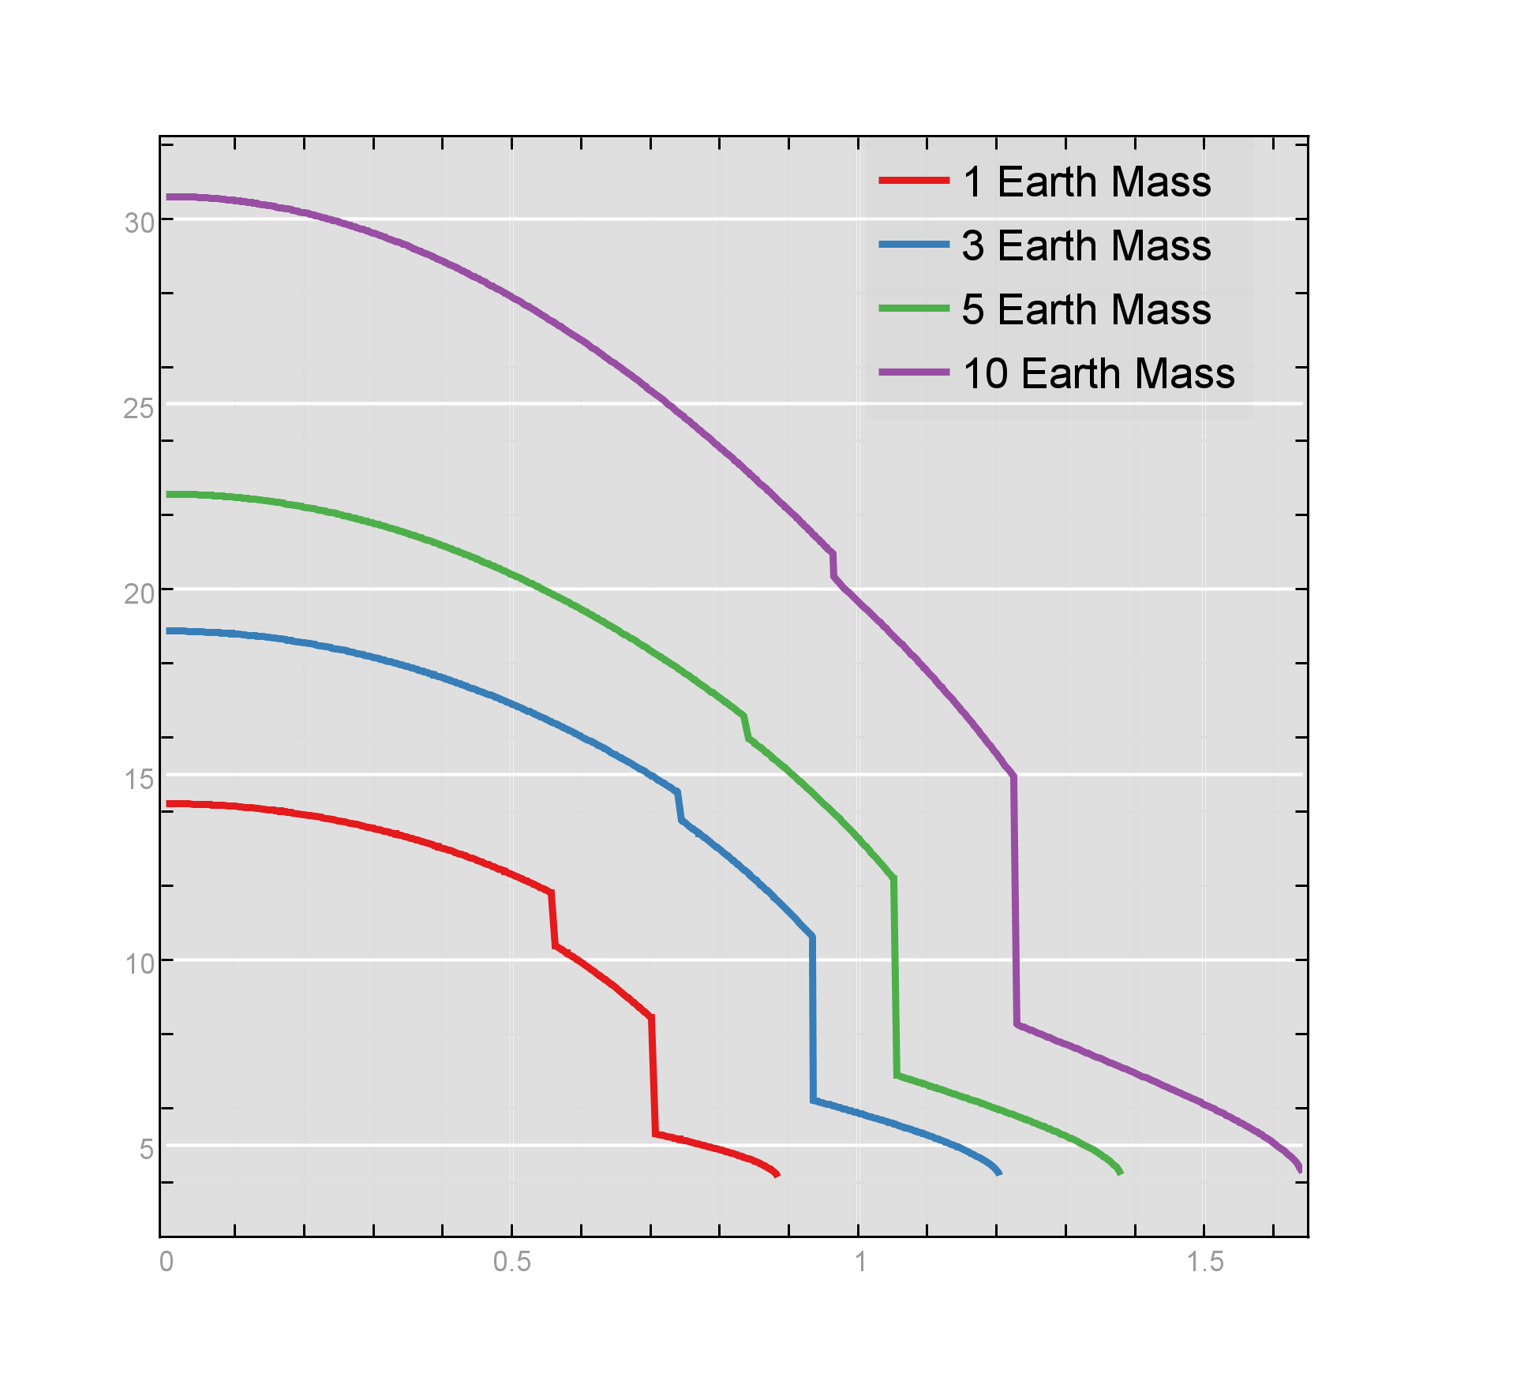


Results
Density g cm⁻³
Radius in R©
Radius in R©
Mass in M©

Slide 10
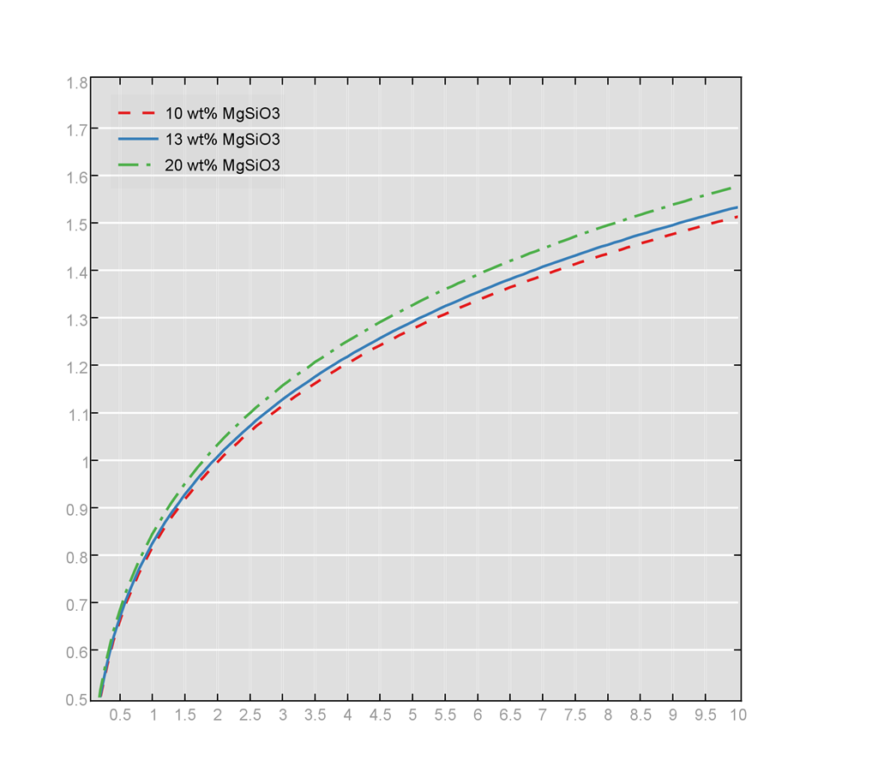
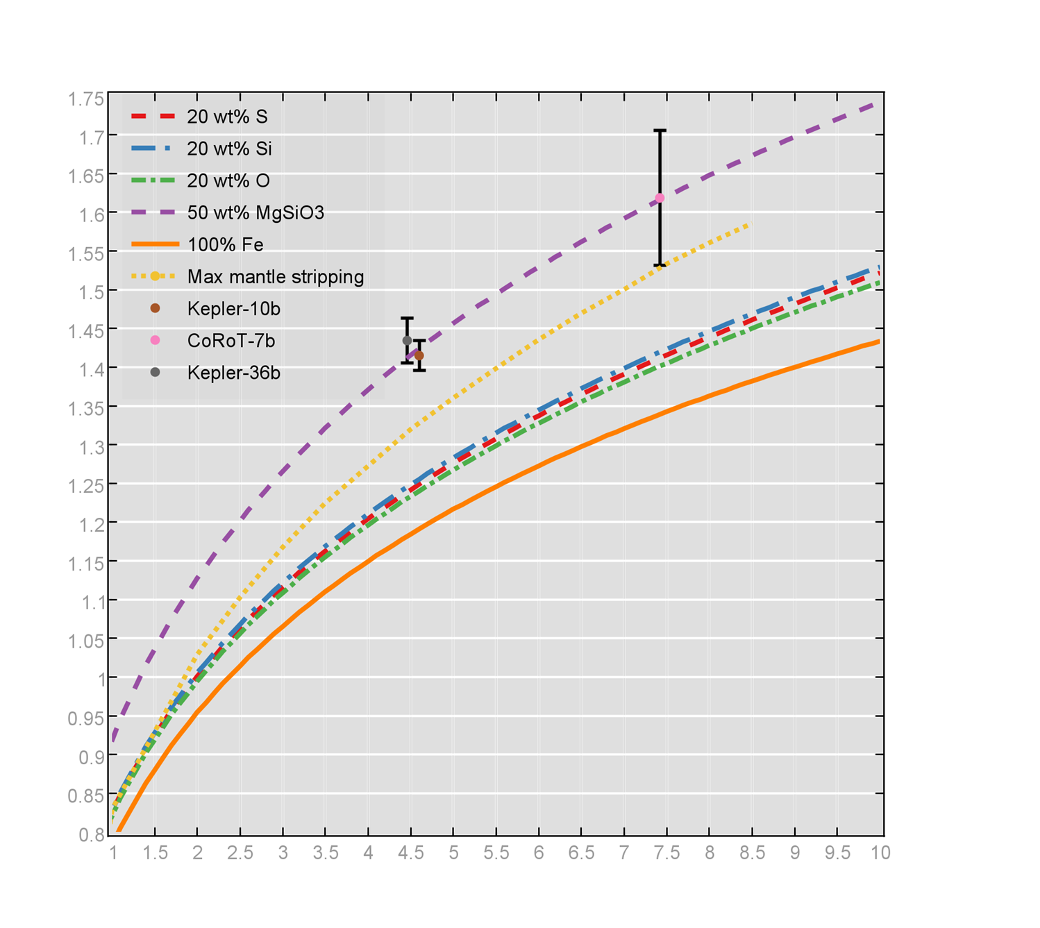
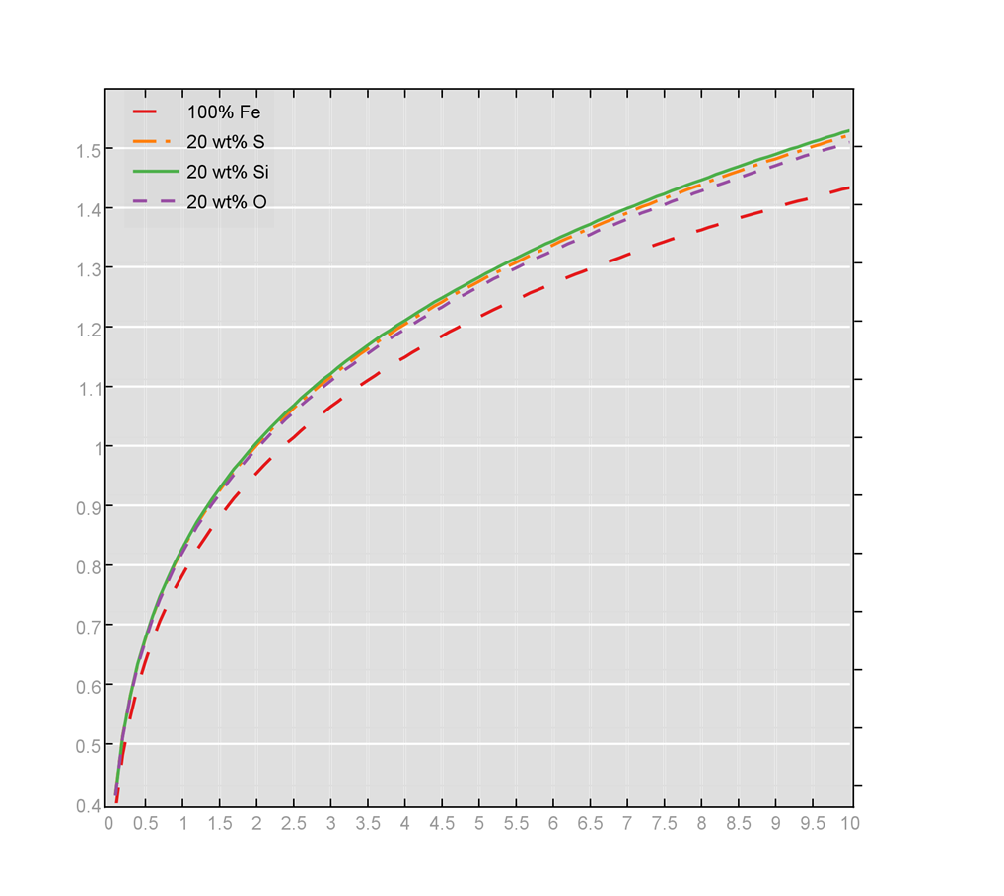
Results
Radius in R©
Radius in R©
Mass in M©
Radius in R©
Mass in M©
Mass in M©

Slide 11
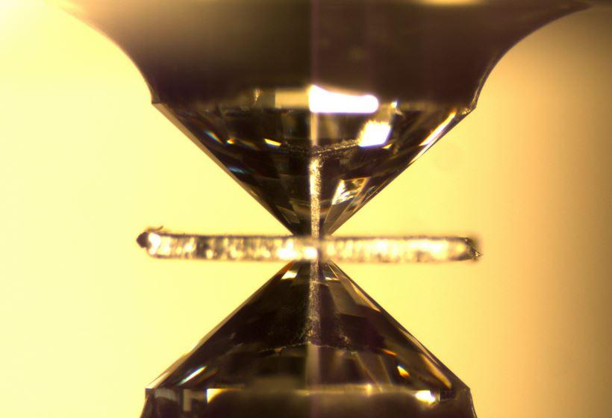
Setbacks
- The need for follow-up observations
- high pressure physics
credit: S.D. Jacobsen, Northwestern University

Slide 12

The future
- Zombie Kepler
- TESS
- Extremely Large Telescope

Slide 13
Conclusions
By reasonably extrapolating equations of state, we have calculated for the compression of materials within a planet using a regime that takes into account dense polymorphs and differentiated layers.
We have built a user friendly program in Java to carry these calculations.
With this program we may consider many models and put constraints on plausible observations.

Slide 14
References & Aknowledgements
Riner, M. A., Bina, C. R., Robinson, M. S., & Desch, S. J. (2008). Internal structure of mercury: Implications of a molten core. JOURNAL OF GEOPHYSICAL RESEARCH, 113,
Zeng, L., & Sasselov, D. (2013). A detailed model grid for solid planets from 0.1 through 100 earth masses. Manuscript submitted for publication, Astronomy Department, Harvard University, Cambridge, MA.
NASA Space Grant
Mentor: Dr. Steven Desch

